Slide 1
فضای سایبر و قدرت
جلسه 24
Cyberspace and Power

Slide 2
فضای سایبر و قدرت
1
قدرت

Slide 3
قدرت
Power
توانایی تحمیل اراده بر دیگری
قدرت
Power

Slide 4

اتیمولوژی «پاور»
(قدرت)
Etymology of “Power”
Ref: https://www.google.com/search?q=power+etymology
Notes:
human (n.)
"a human being," 1530s, from human (adj.). Its Old English equivalent, guma, survives only in disguise in bridegroom.
human (adj.)
mid-15c., humain, humaigne, "human," from Old French humain, umain (adj.) "of or belonging to man" (12c.), from Latin humanus "of man, human," also "humane, philanthropic, kind, gentle, polite; learned, refined, civilized." This is in part from PIE *(dh)ghomon-, literally "earthling, earthly being," as opposed to the gods (from root *dhghem- "earth"), but there is no settled explanation of the sound changes involved. Compare Hebrew adam "man," from adamah "ground." Cognate with Old Lithuanian žmuo (accusative žmuni) "man, male person."
Human interest is from 1824. Human rights attested by 1680s; human being by 1690s. Human relations is from 1916; human resources attested by 1907, American English, apparently originally among social Christians and based on natural resources. Human comedy "sum of human activities" translates French comédie humaine (Balzac); see comedy.
https://www.etymonline.com/word/human#etymonline_v_16039

Slide 5
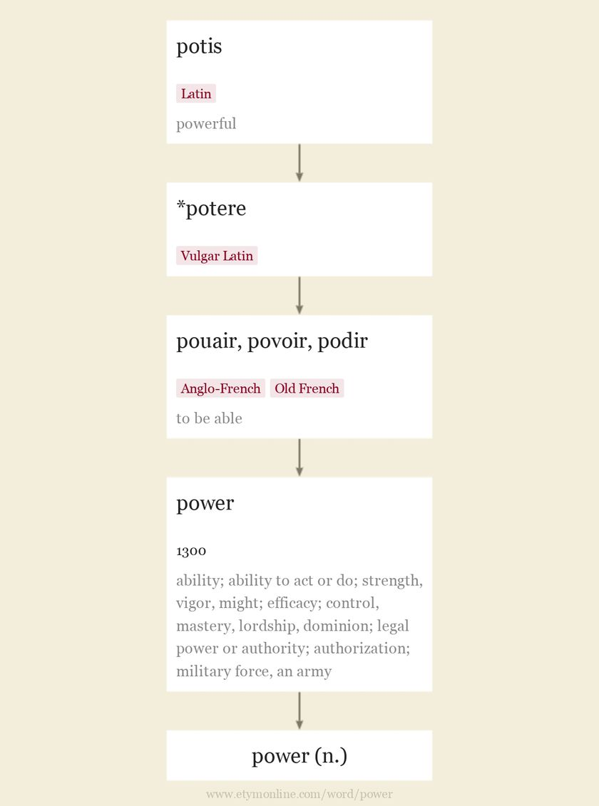
Notes:
power (n.)
c. 1300, pouer, "ability; ability to act or do; strength, vigor, might," especially in battle; "efficacy; control, mastery, lordship, dominion, ability or right to command or control; legal power or authority; authorization; military force, an army," from Anglo-French pouair, Old French povoir, noun use of the infinitive, "to be able," earlier podir (9c.), from Vulgar Latin *potere (source also of Spanish poder, Italian potere), from Latin potis "powerful" (from PIE root *poti- "powerful; lord").
Whatever some hypocritical ministers of government may say about it, power is the greatest of all pleasures. It seems to me that only love can beat it, and love is a happy illness that can't be picked up as easily as a Ministry. [Stendhal "de l'Amour," 1822]
Meaning "one who has power, person in authority or exercising great influence in a community" is late 14c. Meaning "a specific ability or capacity" is from early 15c. In mechanics, "that with which work can be done," by 1727.
Sense of "property of an inanimate thing or agency of modifying other things" is by 1590s. Meaning "a state or nation with regard to international authority or influence" [OED] is from 1726. Meaning "energy available for work is from 1727. Sense of "electrical supply" is from 1896.
Colloquial a power of for "a large quantity of, a great number of" is from 1660s (compare powerful). Phrase the powers that be "the authorities concerned" is from Romans xiii.1. As a statement wishing good luck, more power to(someone) is recorded from 1842. A man-advantage power play in ice hockey so called by 1940. Power failure "failure of the (electrical) power supply" is from 1911; power steering in a motor vehicle is from 1921. Power politics "political action based on or backed by threats of force" (1937) translates German Macht-politik.

Slide 6
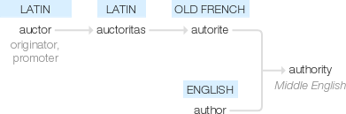
اتیمولوژی «اوتوریته»
(اقتدار)
Etymology of “Authority”
Ref: https://www.google.com/search?q=power+etymology
Notes:
human (n.)
"a human being," 1530s, from human (adj.). Its Old English equivalent, guma, survives only in disguise in bridegroom.
human (adj.)
mid-15c., humain, humaigne, "human," from Old French humain, umain (adj.) "of or belonging to man" (12c.), from Latin humanus "of man, human," also "humane, philanthropic, kind, gentle, polite; learned, refined, civilized." This is in part from PIE *(dh)ghomon-, literally "earthling, earthly being," as opposed to the gods (from root *dhghem- "earth"), but there is no settled explanation of the sound changes involved. Compare Hebrew adam "man," from adamah "ground." Cognate with Old Lithuanian žmuo (accusative žmuni) "man, male person."
Human interest is from 1824. Human rights attested by 1680s; human being by 1690s. Human relations is from 1916; human resources attested by 1907, American English, apparently originally among social Christians and based on natural resources. Human comedy "sum of human activities" translates French comédie humaine (Balzac); see comedy.
https://www.etymonline.com/word/human#etymonline_v_16039

Slide 7
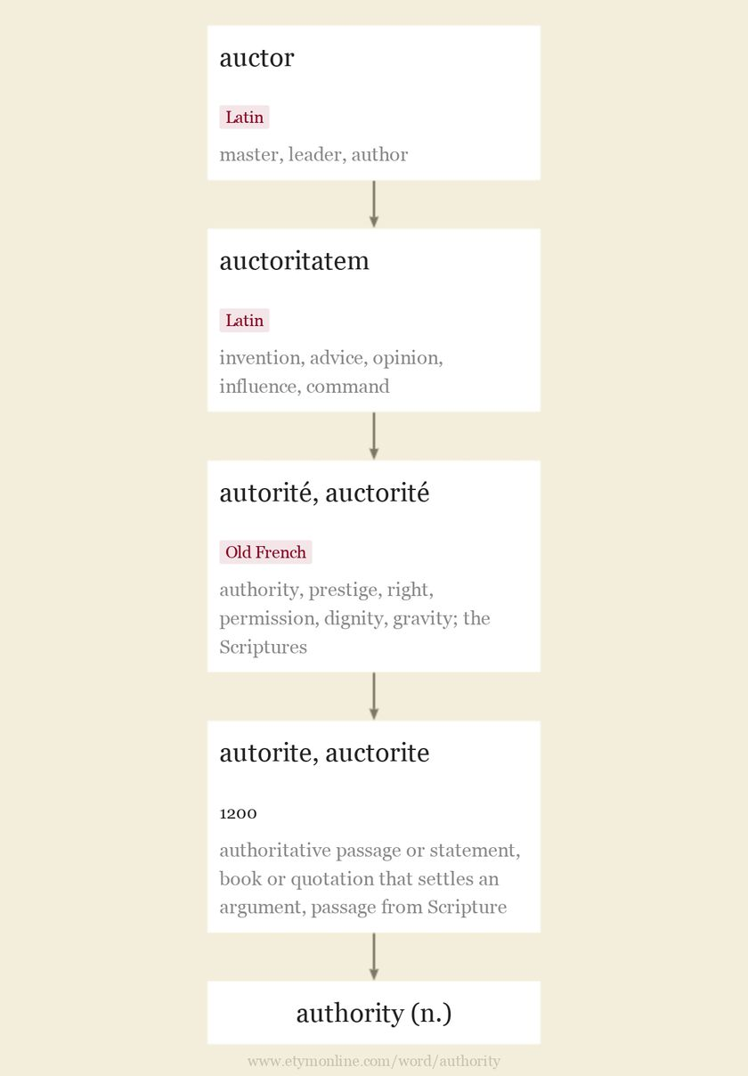
Notes:
authority (n.)
c. 1200, autorite, auctorite "authoritative passage or statement, book or quotation that settles an argument, passage from Scripture," from Old French autorité, auctorité "authority, prestige, right, permission, dignity, gravity; the Scriptures" (12c.; Modern French autorité), from Latin auctoritatem (nominative auctoritas) "invention, advice, opinion, influence, command," from auctor "master, leader, author" (see author (n.)). Usually spelled with a -c- in English before 16c., when the letter was dropped in imitation of French, then with a -th-, probably by influence of authentic.
From c. 1300 in the general sense "legal validity," also "authoritative book; authoritative doctrine" (opposed to reason or experience); "author whose statements are regarded as correct." From mid-14c. as "right to rule or command, power to enforce obedience, power or right to command or act." In Middle English also "power derived from good reputation; power to convince people, capacity for inspiring trust." From c. 1400 as "official sanction, authorization." Meaning "persons in authority" is from 1610s; Authorities "those in charge, those with police powers" is recorded from mid-19c.

Slide 8
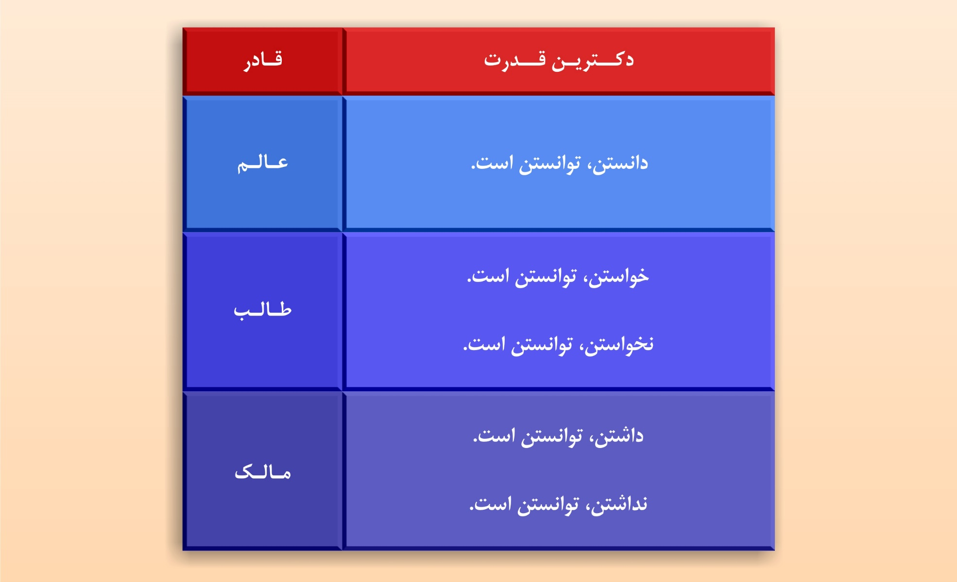
دکترین‌های قدرت
Ref: http://www.kolbeh-keramat.ir/Sessions/Single/207

Slide 9
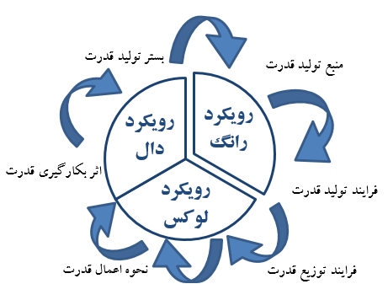


Slide 10
فضای سایبر و قدرت
2
میدان
تولید
قدرت

Slide 11
میدان تولید قدرت
میدان تولید قدرت
ضعف
اراده
احتیاج
قوت
Ref: http://www.kolbeh-keramat.ir/Sessions/Single/207

Slide 12
میدان تولید قدرت
قدرت احتیاج‌محور
میدان تولید قدرت
ضعف
اراده
احتیاج
قوت
Ref: http://www.kolbeh-keramat.ir/Sessions/Single/207

Slide 13
میدان تولید قدرت
قدرت اراده‌محور
میدان تولید قدرت
ضعف
اراده
احتیاج
قوت
Ref: http://www.kolbeh-keramat.ir/Sessions/Single/207

Slide 14
میدان تولید قدرت
قدرت قوت‌محور
میدان تولید قدرت
ضعف
اراده
احتیاج
قوت
Ref: http://www.kolbeh-keramat.ir/Sessions/Single/207

Slide 15
میدان تولید قدرت
قدرت ضعف‌محور
میدان تولید قدرت
ضعف
اراده
احتیاج
قوت
Ref: http://www.kolbeh-keramat.ir/Sessions/Single/207

Slide 16
فضای سایبر و قدرت
3
منابع
قدرت

Slide 17
منابع قدرت ارگانیکی
قدرت ارگانیکی
فرهنگی
سیاسی
اجتماعی
اقتصادی
نظامی

Slide 18
نسبت منابع قدرت ارگانیکی با اکچوآلیته و ویرچوآلیته
فضای
فرهنگی
سیاسی
اجتماعی
اقتصادی
نظامی
اکچوآل

Slide 19
منابع قدرت سایبرنتیکی
قدرت سایبرنتیکی
اطلاعات
انرژی

Slide 20
نسبت منابع قدرت سایبرنتیکی با اکچوآلیته و ویرچوآلیته
ویرچوآل
اطلاعات
انرژی
اکچوآل

Slide 21
فضای سایبر و قدرت
4
قدرت
از منظر
صلابت

Slide 22
قدرت از منظر صلابت
قدرت از منظر صلابت
نرم
نیمه‌سخت
سخت

Slide 23
قدرت از منظر صلابت
طیف‌شناسی قدرت
قدرت از منظر صلابت
قدرت نرم
قدرت نیمه‌سخت
قدرت سخت
اختیار
کراهت / اکراه
جبر / اجبار
وسیله
اقناع و ارضاء
تشویقی ـ تنبیهی
قهری
روش
ارشاد
اغواء
رشد
غی

Slide 24
نسبت طیف قدرت با منابع قدرت ارگانیکی
نرم
نیمه‌سخت
سخت
طیف قدرت
فرهنگی
اقتصادی
نظامی
منابع قدرت
اجتماعی
سیاسی

Slide 25
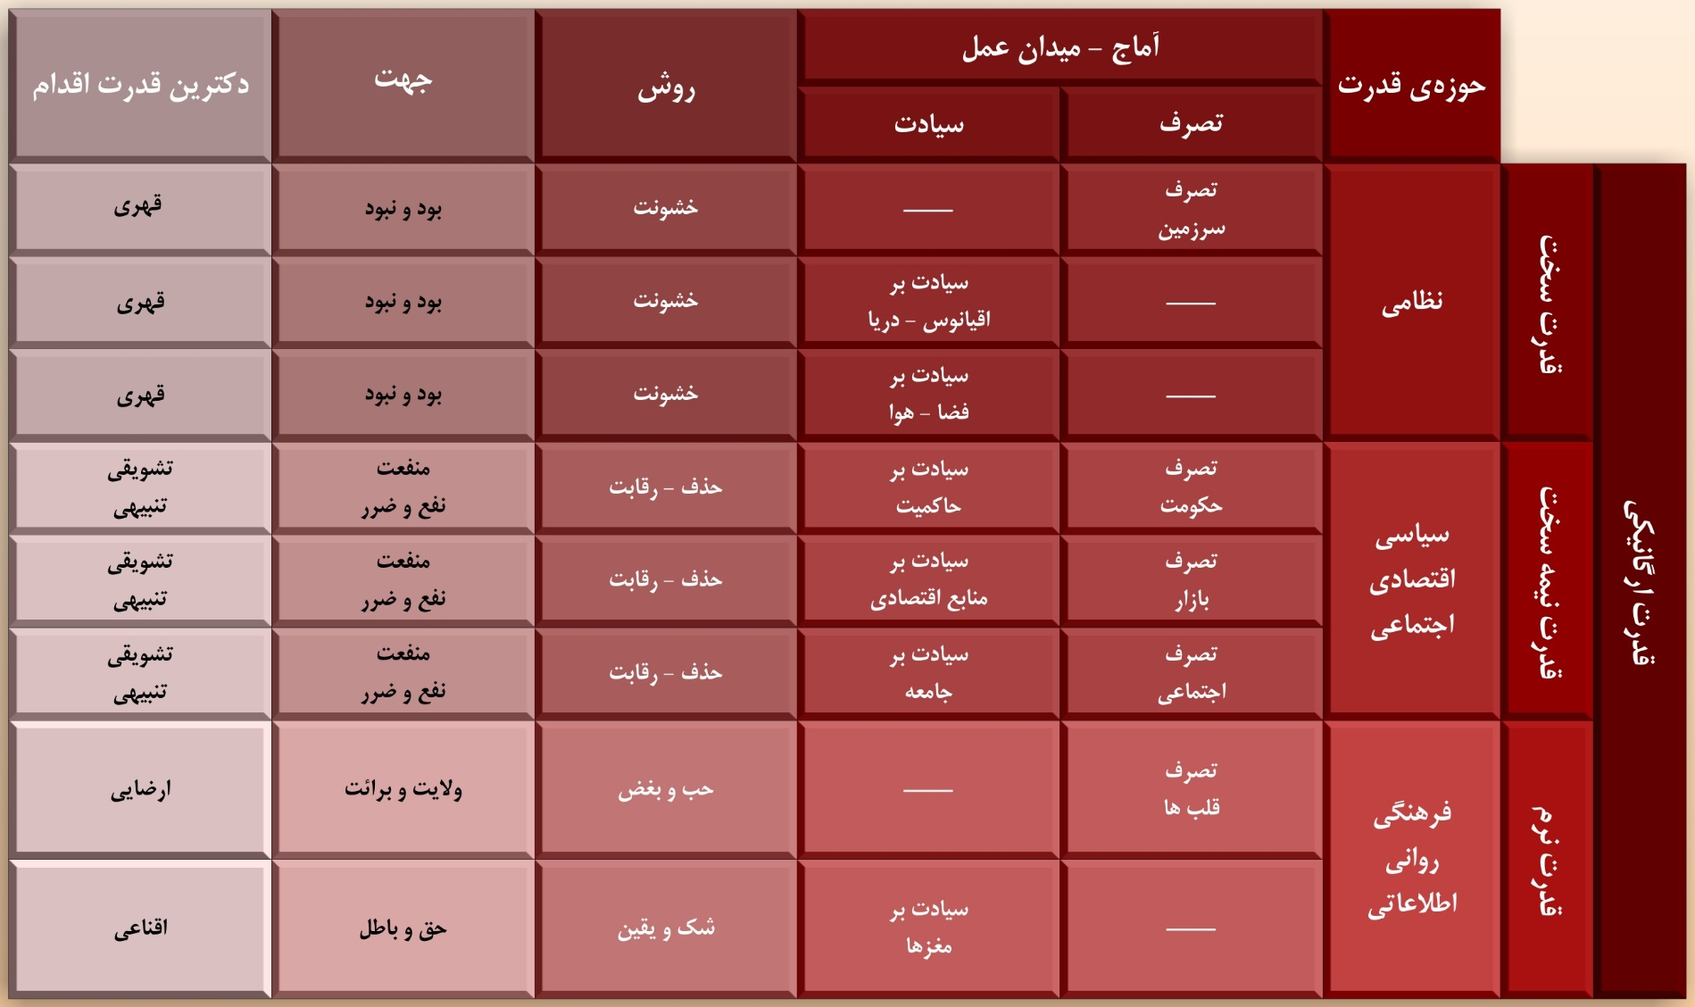
نسبت طیف قدرت با منابع قدرت ارگانیکی
حوزه، آماج، روش، جهت و دکترین اقدام
Ref: http://www.kolbeh-keramat.ir/Sessions/Single/207

Slide 26
نسبت طیف قدرت با منابع قدرت سایبرنتیکی
نرم
نیمه‌سخت
سخت
طیف قدرت
اطلاعات
سایبر
انرژی
منابع قدرت
آگاهی
کنترل
نیرو
اراده

Slide 27
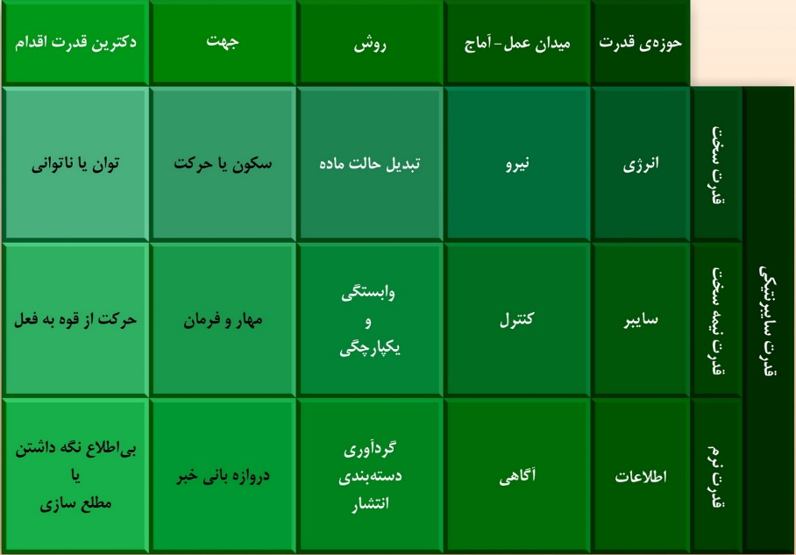
نسبت طیف قدرت با منابع قدرت سایبرنتیکی
حوزه، آماج، روش، جهت و دکترین اقدام
Ref: http://www.kolbeh-keramat.ir/Sessions/Single/207

Slide 28
فضای سایبر و قدرت
5
نقش
قدرت
در
فضای سایبر

Slide 29
فضای سایبر و قدرت
قدرت از منظر صلابت
میدان تولید قدرت
نرم
نیمه‌سخت
سخت
ضعف
قدرت ارگانیکی
فرهنگی
سیاسی
اجتماعی
اقتصادی
نظامی
اراده
احتیاج
قدرت سایبرنتیکی
قوت
اطلاعات
انرژی

Slide 30
مدل پیشنهادی مطالعه‌ی فضای سایبر
دنیا
World
انسان
Human
کاربرد
Application
زیرساخت
Infrastructure

Slide 31
مدل پیشنهادی مطالعه‌ی فضای سایبر
نقش «قدرت»
قدرت
در نسبت با «دنیا»
دنیا
World
قدرت
در نسبت با «انسان»
انسان
Human
قدرت
تولید شده از «کاربرد»
کاربرد
Application
قدرت
تولید شده از «زیرساخت»
زیرساخت
Infrastructure

Slide 32
قدرت تولید شده از زیرساخت
مؤلفه‌های زیرساختی فضای سایبر
محاسبات
Computation
ارتباطات
Communication
کنترل
Control
اطلاعات
Information
پردازش اطلاعات
انتقال اطلاعات
تغذیه‌ اطلاعات
محتوا
قدرت محاسباتی
قدرت ارتباطاتی
قدرت کنترلی
قدرت اطلاعاتی

Slide 33
نسبت قدرت تولید شده از مؤلفه‌های زیرساختی با اکچوآلیته و ویرچوآلیته
ویرچوآل
محاسبات
Computation
ارتباطات
Communication
کنترل
Control
اطلاعات
Information
اکچوآل

Slide 34
فضای سایبر و قدرت
6
منابع
و
مراجع

Slide 35
کتاب مرجع

Slide 36
کتاب مرجع

Slide 37
کتاب مرجع

Slide 38
کتاب مرجع

Slide 39
کتاب مرجع

Slide 40
کتاب مرجع

